Slide 1
Testing a Dynamic Web Platform for Enhancing Teaching in the Field of Computer Science
Austin hunt, Bryce Charydczak
28 November 2017
CSCI 362: SOFTWARE ENGINEERING

Slide 2
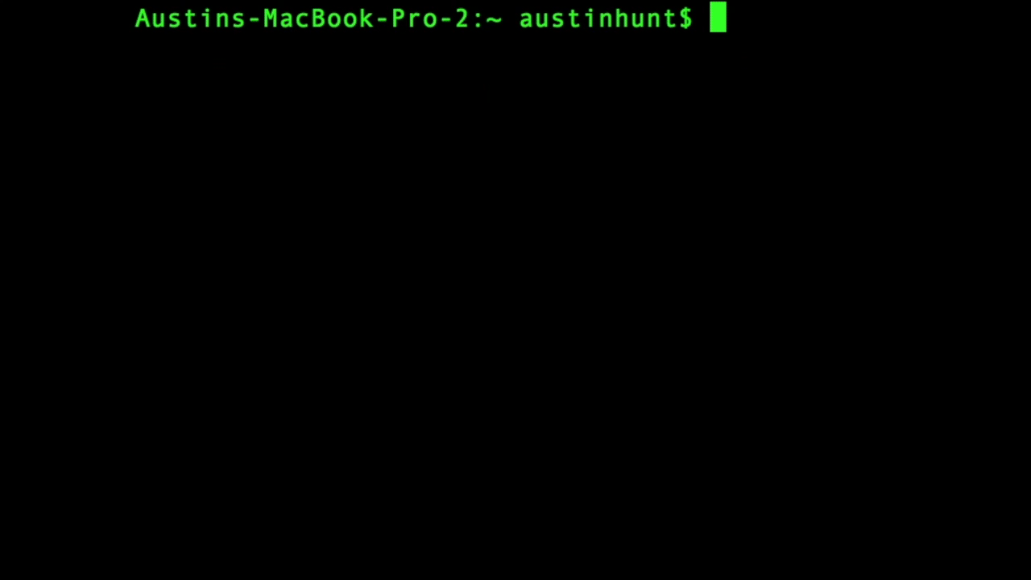
What are we testing?

Slide 3
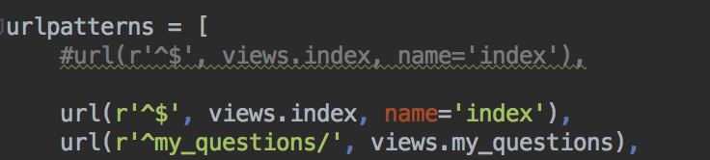
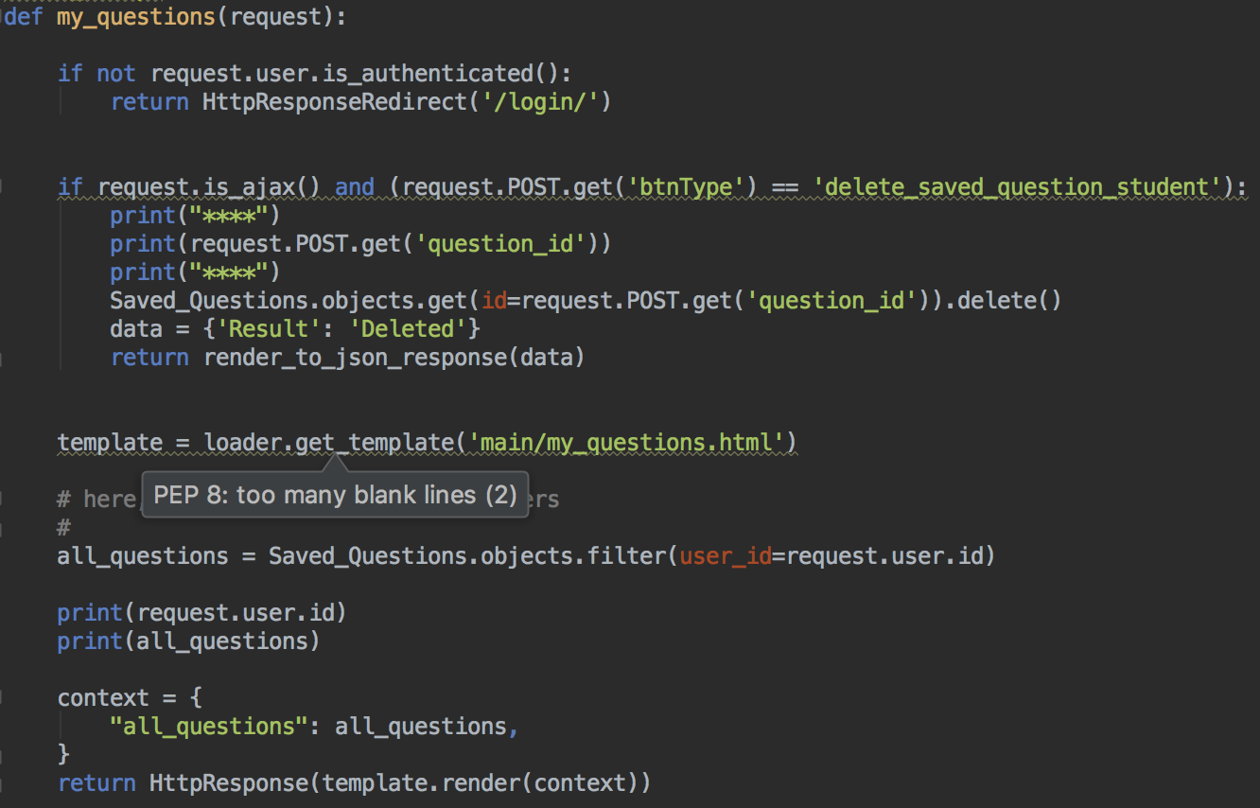
The Django Project: a high-level view
settings.py
urls.py
views.py
Templates
models
http://127.0.0.1:8000/my_questions/ calls views.my_questions
Notes:
Settings contains a bunch of configuration information, like info about the data base the project is communicating with
Urls contains list of url patterns that, when matched by a request, call a function, and these functions are defined in views
These functions do things like check if the user is authenticated, they check for ajax requests, they manipulate and read from the data in the database, and they ultimately return pages to the user; these pages are defined in a templates subdirectory

Slide 4
Methods Being Tested
checkIfOverflow
cofc_convert_decimal_to_sign_magnitude
cofc_convert_decimal_to_unsigned_binary_with_length
cofc_decimal_to_ones_complement
cofc_ones_complement_to_decimal
convert_simple_line_c_to_mips
views.py (index function)
Notes:
Fortunately, one of the easier aspects of our project was that all of the methods we wanted to test were localized in the same file; views.
All of these methods are used primarily in the index function, which is essentially the function that returns the home page to the user; this page has practice questions which use these methods; there are multiple questions asking for different conversions and whether or not adding unsigned binaries creates overflow

Slide 5
The Script: Part One
Path of Execution:
cd into testCases subdirectory
Repeat the following for every testCase file
initialize COUNTER to 1 (to be used to assign names to the lines of the .txt file)
if current directory is not /testCases, cd into testCases
Repeat the following for each line of the txt file
if COUNTER is 1 then testCaseNum is the line, print the test case number
if COUNTER is 2 then reqToTest is the line, print reqToTest
if COUNTER is 3 then component is the line, print component
If COUNTER is 4 then unit is line, print unit
if COUNTER is 5, then args is the line (to be passed to the function)
if COUNTER is 6, set oracle = line,
cd into testCaseExecutables, and execute the $unit.py file while passing in $args and $oracle; output to tempTestOutput.txt
Compare output, oracle → PASS/FAIL
increment COUNTER
Key: $COUNTER
Before assigning, compare to line; if different, NEW METHOD
ONE BIG PROBLEM: NOT USING LIVE CODE

Slide 6
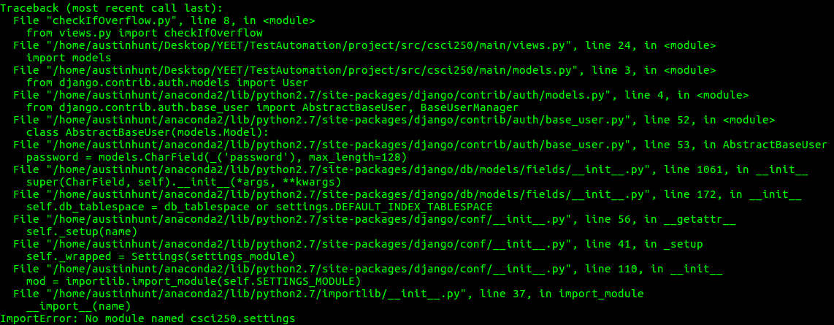
Configuration problems: 10 hours of Addlestone
Import statements rejected

Slide 7
New approach!
Write a supplementary script to parse a given file and extract the needed method bodies
☑
getMethodBody.sh
Cd into project source code
cat $1.py | awk "/def $2/,/NEW_FUNCTION/" > $methodBodyFile
Empty, refill the driver
Method name
Temporary file
File name (views)

Slide 8
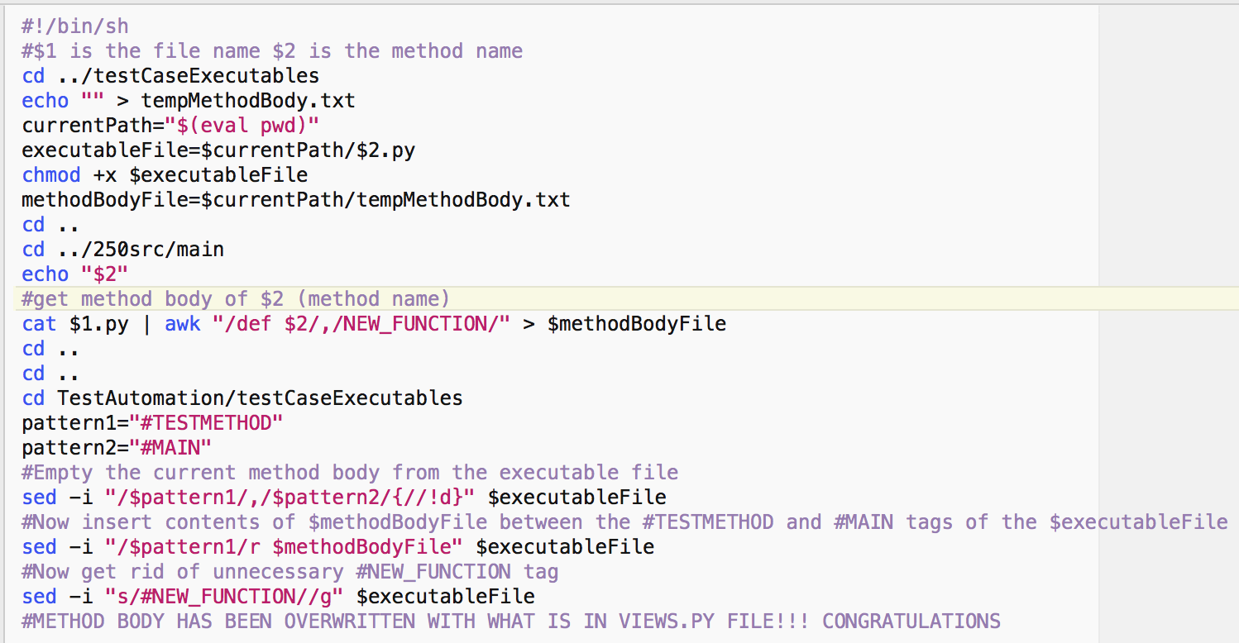
getMethodBody.sh : short & sweet

Slide 9
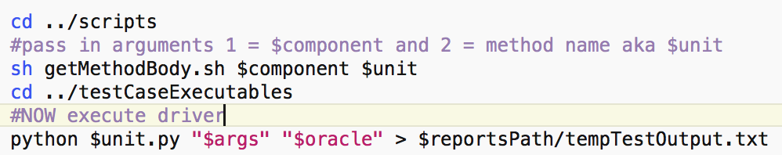
Fixing the runAllTests script:
before calling:
python $unit.py "$args" "$oracle" > $reportsPath/tempTestOutput.txt
Use the getMethodBody.sh script:
sh getMethodBody.sh $component $unit
Dynamic, always updated

Slide 10
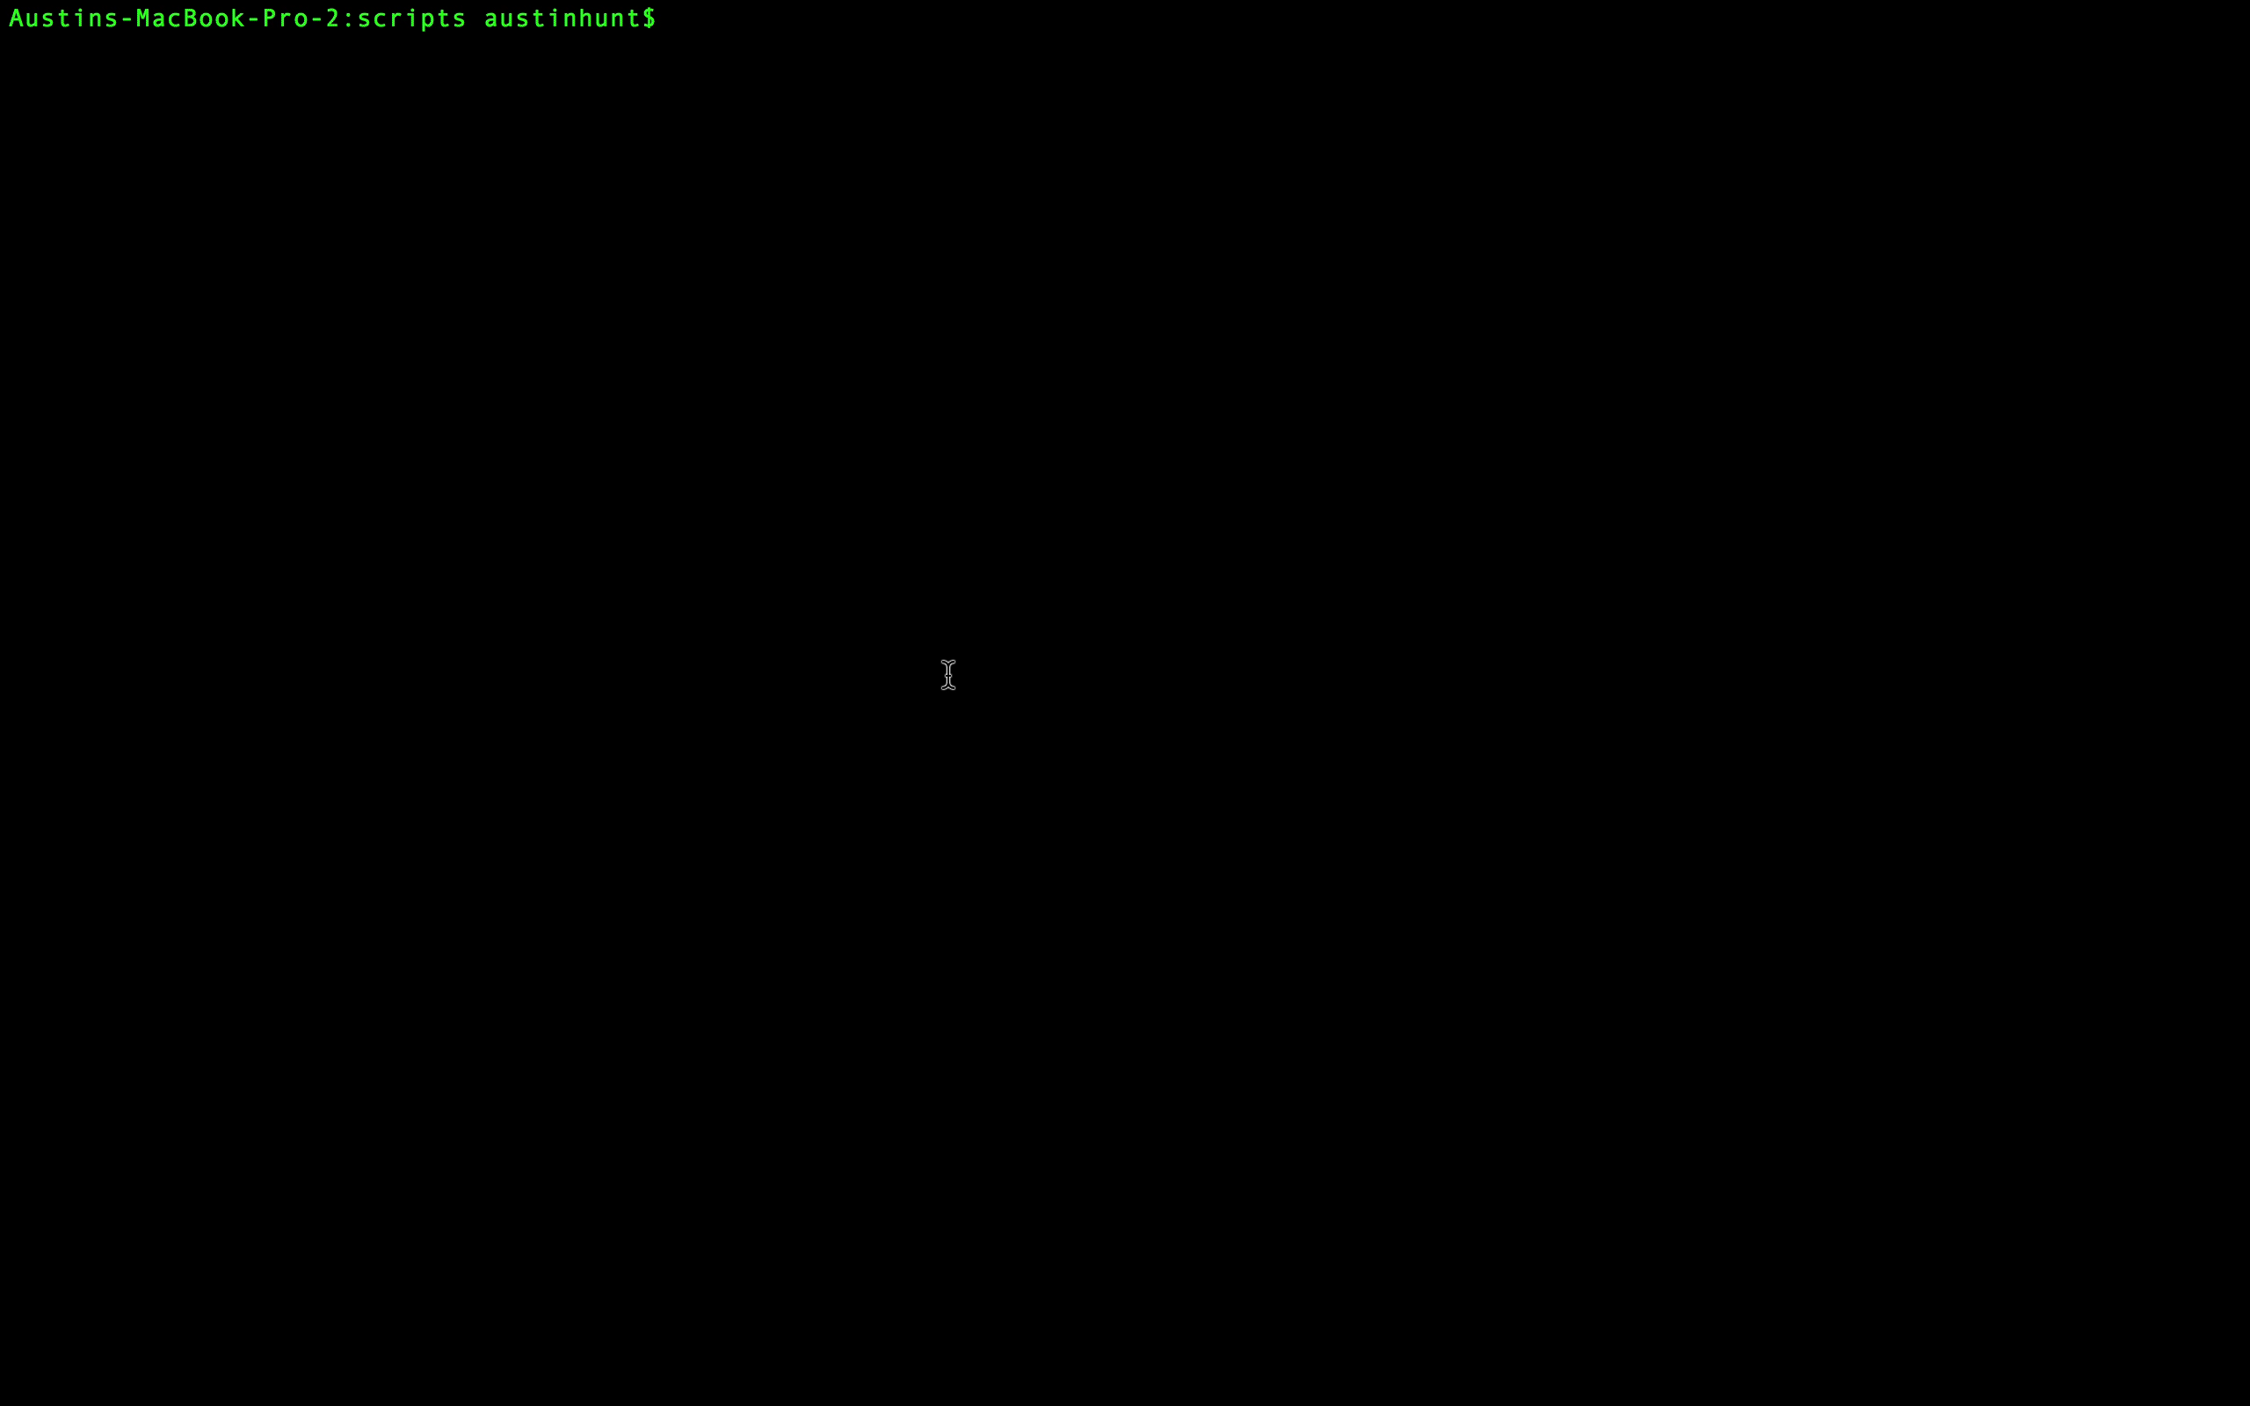
Running the Tests:
Backup screen recording:

Slide 11
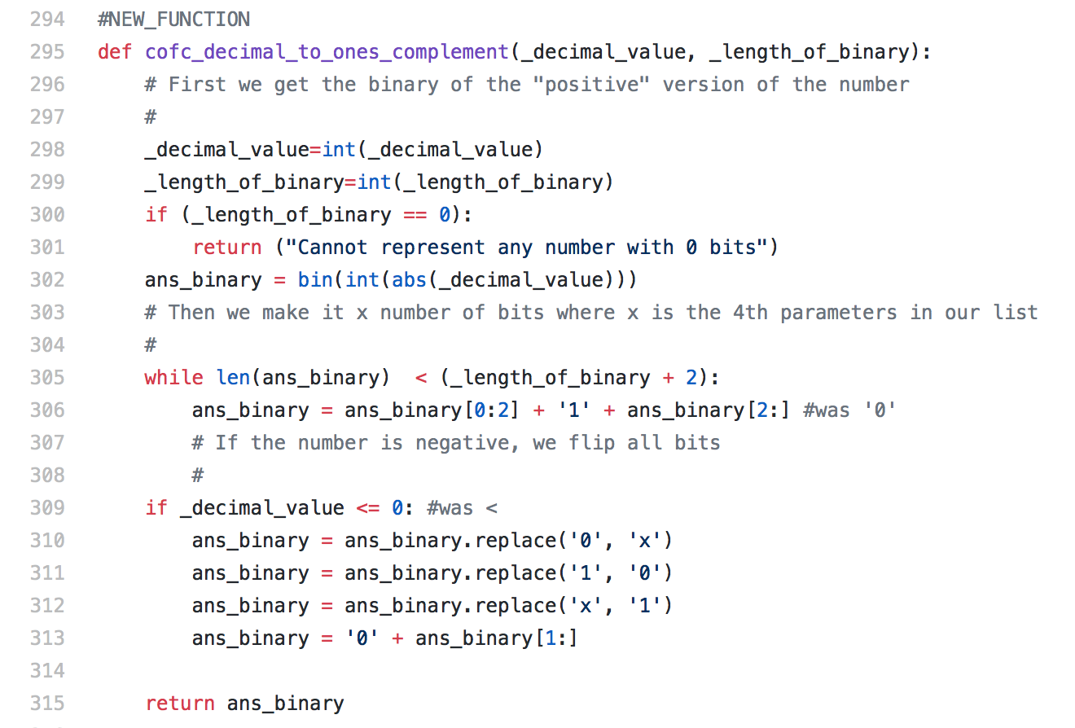
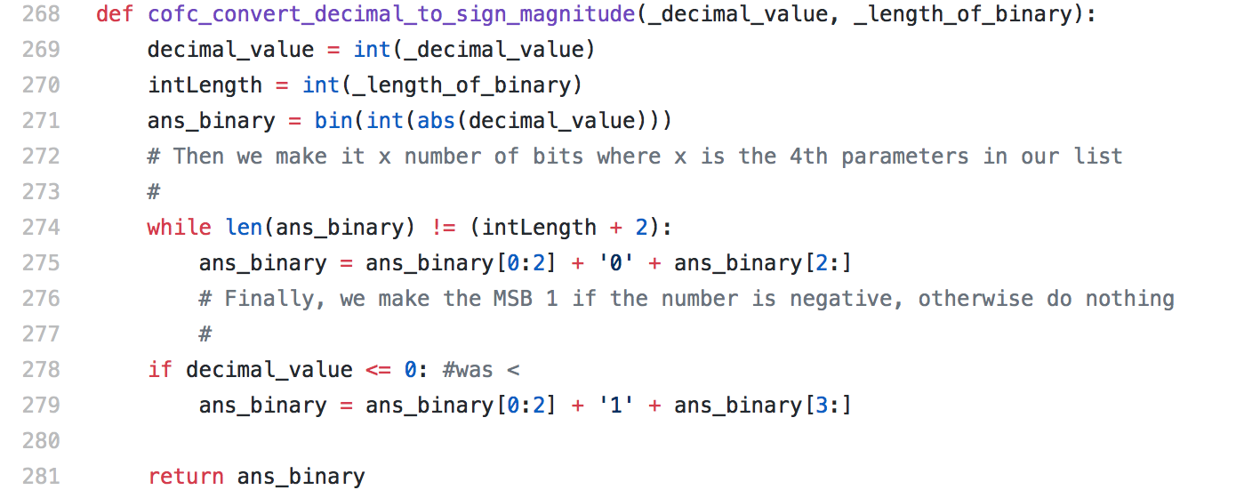
Fault Injections: Breaking the Code

Slide 12
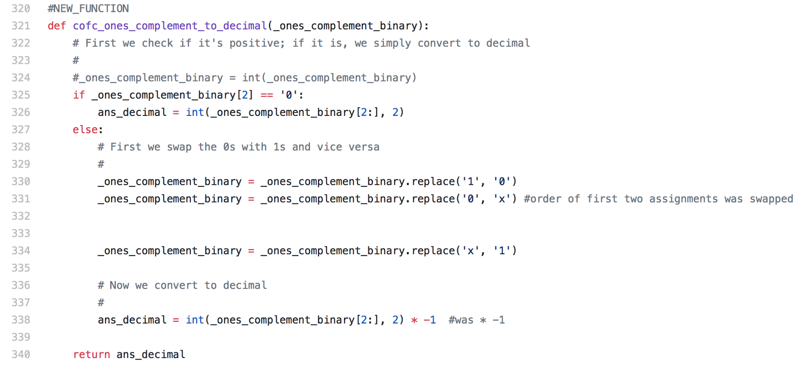
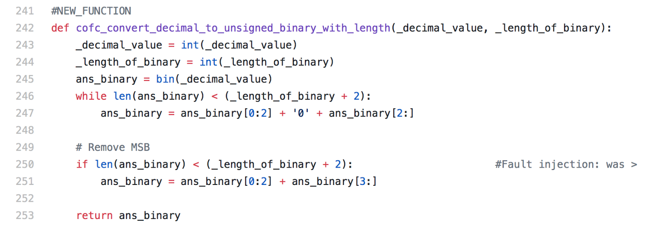

Slide 13
What’d we learn?
New skills
SCRIPT-WRITING!!
Executing python drivers with arguments
HTML
CSS, styling
Parsing with awk, sed
Automation makes testing easy, but creating an automated framework takes time … and patience

